Slide 1

Understanding the Wyoming Broadband Equity, Access, and Deployment (BEAD) Prequalification Application
August 2024

Slide 2

introduction
Chad Bolling
      Broadband Manager, Wyoming Business Council
      Aimee Meacham
      Director of State Broadband Programs, CTC
      Julie Park
      Senior Analyst, CTC

Slide 3

agenda
BEAD Program overview
Prequalification background
WBO’s Prequalification application
Submitting an application
Final notes

Slide 4
BEAD overview

Slide 5

Bead Program background
The Broadband Equity, Access, and Deployment (BEAD) Program was created by the bipartisan Infrastructure Investment and Jobs Act (IIJA)
Allocates $42.45 billion of federal funding to all 50 states, Washington D.C., and territories
Administered by the National Telecommunications and Information Administration (NTIA)
Goal of expanding high-speed internet access through infrastructure deployment and adoption programs
Prioritizes funds for unserved locations first (those that cannot get internet service of 25/3 Mbps) and underserved second (those that can get internet service between 25/3 and 100/20 Mbps only)
What is the BEAD Program?

Slide 6
The Wyoming bead program
Wyoming was allocated $348 million to support the deployment of broadband infrastructure.
WBO has submitted to the federal government the first three of four required BEAD plans, including the second volume of the Initial Proposal, which describes the state’s grant program design, proposed subgrantee selection process, grant application scoring criteria, plans for workforce development, and affordability strategies, among other relevant information
These documents plus additional information can be found here: https://wyomingbusiness.org/broadband/bead/
Prequalification Process, followed by grant program
BEAD Planning
Deployment
2023
2024
2025

Slide 7
Overall BEAD status and timeline
2023
2024
Q1-2
2024
Q3
2024
Q4
2025 >
1
Community engagement
Continues through planning and execution cycles
2
Digital Access planning and programs
Planning and Digital Access Plan
State grants
Federal grants
3
BEAD planning
5-Year Action Plan and Initial Proposal
Final Proposal to federal gov’t
4
BEAD grant
program
Challenge Process
Subgrantee Selection and grant program
5
BEAD deployment
Deployment
We are here:
Prequalification

Slide 8
BEAD grant application process timeline
Prequalification Phase
Negotiation Phase
Final Submission
Scoring Phase
Prequalification materials released
BEAD grant application materials released
Public comment period and announcement of provisional BEAD grant awards
Prequalification workshop/webinar
Negotiation process and/or second phase grant window open
BEAD grant application workshop/webinar
Prequalification applications accepted by WBO
Review of BEAD grant application materials, including curing as necessary
Submission of the draft BEAD Final Proposal to NTIA (within 365 days of approval of Initial Proposal Volume II)
BEAD applications accepted by WBO
Announcement of prequalification determinations
WBO review of BEAD grant application submissions, including curing as necessary

Slide 9
Prequalification background

Slide 10

What is prequalification?
The first phase of a fair and transparent multi-part BEAD Program grant selection process
Gives subgrantee applicants time to prepare information about their financial and organizational capabilities to demonstrate their basic qualifications for BEAD subgrant eligibility
Prequalifies subgrantee applicants to prepare and submit a project-specific funding application during the Scoring Phase of WBO’s BEAD grant program

Slide 11
Why conduct a prequalification phase?
1
Helps subgrantee applicants with BEAD’s compressed timeline
2
Helps manage resources efficiently
3
Provides sufficient opportunity for revisions
Allows subgrantee applicants to spread their grant application efforts across a longer timeline
Requires one prequalification application per subgrantee applicant (even if later submitting multiple proposals) and ensures subgrantee applicants can meet the required minimum criteria for BEAD subgrants
Gives additional time for follow-up data requests by WBO and provision of additional information by subgrantee applicants to ensure as many qualified subgrantee applicants as possible for Wyoming

Slide 12
Principles of prequalification
WBO will consider whether the prequalification application conforms to the following principles:
Quality: The material provided must be thorough and directly aligned with the request
Completeness: WBO will consider whether there are any omissions or indications that might give rise to concerns about the history or capabilities of potential subgrantees, their contractors, and subcontractors in meeting the specified standards and statutes
Appropriateness: The materials must indicate compliance with and adherence to the required standards and statutes

Slide 13
WBO’s Prequalification Application

Slide 14
Elements of prequalification
The prequalification application documents minimum eligibility criteria established by the BEAD NOFO:
Financial capability: Certifications and documentation, letter of credit compliance statement, audited financial statements
Organizational capability: Key management resumes, organizational charts, certification of operational readiness, evidence of prior service in relevant areas, compliance with regulatory filings
Certifications and compliance: Adherence to federal, state, and local laws, compliance with occupational safety regulations
Federal labor and employment laws: Adherence to federal labor and employment laws, documentation of labor and employment practices
Risk management: Cybersecurity and supply chain risk management plans, reevaluations, and updates
Ownership: Ownership information required by 47 C.F.R. § 1.2112(a)(1)-(7)

Slide 15
Organizational information
Organizational information chart indicating management personnel and company structure
Resumes of key personnel, including financial, technical, and management personnel positions
Key required information:
      Ownership information (consistent with 47 C.F.R. § 1.2112(a)(1)-(7)), including 10 percent or more owners
      Certifications and licenses held by the business and individual employees, organized by role
SAM.gov registration unique entity identifier (UEI)
A subgrantee applicant does not need to complete full registration to receive a UEI
UEI must be active

Slide 16
Financial qualifications
Audited financial statements from the prior year or equivalent financial information (or a justification as to why such statements may not be available)
Audits must be completed by an independent certified public accountant
This can take several months to complete
A letter of credit or performance bond acknowledgement indicating your understanding of the BEAD Program’s letter of credit or bond requirements and your plan for complying (see NTIA’s guidance for more details: BEAD Letter of Credit Waiver | BroadbandUSA (ntia.gov))

Slide 17
Experience and past projects
Past performance on broadband projects (especially those similar in size and scope to the anticipated BEAD project)
Other public funding that your organization or its affiliates have applied for or intend to apply for (including federal and state funding such as ARPA, RDOF, CAF, CARES, Enabling Middle-Mile Broadband Infrastructure Grant Program) for broadband deployment projects as well as project details for those publicly funded projects
Including project technology, project area, amount of funding requested, amount of match committed, proposed cost of end-user services, and resources committed to the projects

Slide 18
Other compliance requirements
Awareness of and commitment to comply with Environmental and Historic Preservation (EHP) compliance requirements from the National Historic Preservation Act and National Environmental Policy Act, including categorical exclusions
Compliant supply chain and cybersecurity plans that reflect NIST Cybersecurity Framework Version 2.0, Executive Order 14028, NISTIR 8276, and NIST 800-161, or certification that the organization will have such
Acknowledgement of and plan for employment and labor practices in compliance with federal and state laws
Legal opinion acknowledgement indicating your plan to comply in the Scoring Phase by submitting a letter signed by an attorney regarding your qualifications and past compliance with federal and state laws
Documentation of outreach to workers and labor organizations

Slide 19
Additional compliance requirements
For new entrants or subgrantee applicants with less than two years of experience, evidence demonstrating sufficient operational capabilities, including:
Resumes from key personnel describing experience with operations providing broadband services (including those with experience of at least five years in communication industry)
Must include licensing and certification identifiers, years of operating experience, and descriptions of the services provided
Project descriptions and narratives from contractors, subcontractors, or other partners
Other operational or financial reports that may have been originally submitted to a financial institution

Slide 20
Submitting an application

Slide 21

Application resources
Resources to support completion of the application:
Initial Proposal Volume II
Prequalification Application Guide – this document will provide additional guidance on how to navigate the portal, answer questions, and complete an application
Prequalification templates – these documents should be downloaded, completed, and uploaded for the appropriate questions
https://wyomingbusiness.org/broadband/bead/
Email: broadbandoffice@wyo.gov

Slide 22
Organization accounts & access
Subgrantee applicants who have existing accounts with WBC:
Subgrantee applicants will have the opportunity to update primary contact information if different from previous programs
New entrant applicants who do not have existing accounts with WBC:
Subgrantee applicants will need to provide organizational business information and be verified by WBC before starting the application

Slide 23
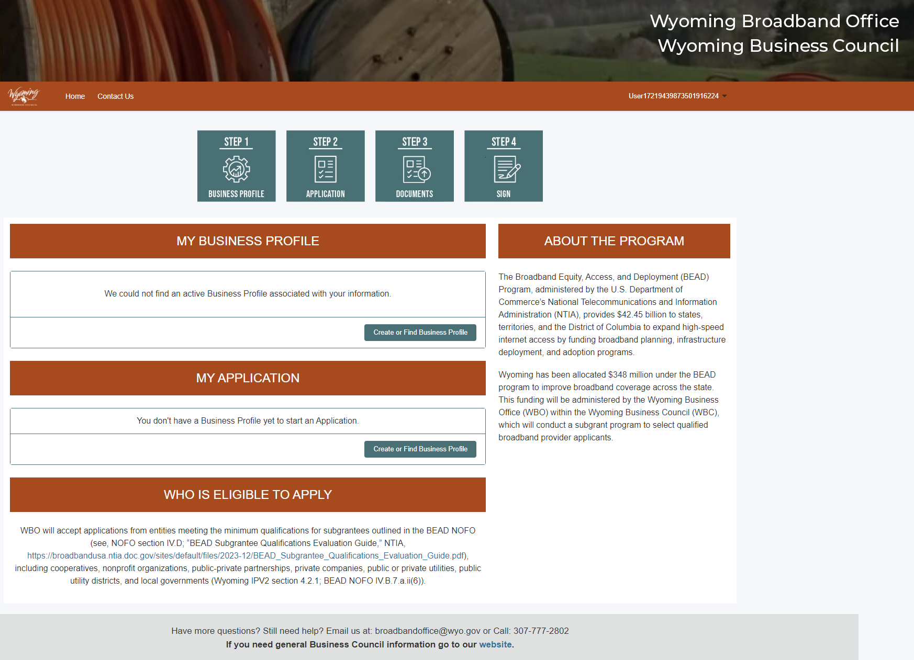
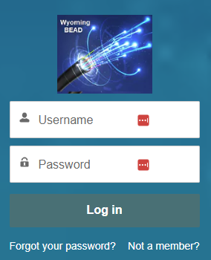
Organization accounts & access

Slide 24
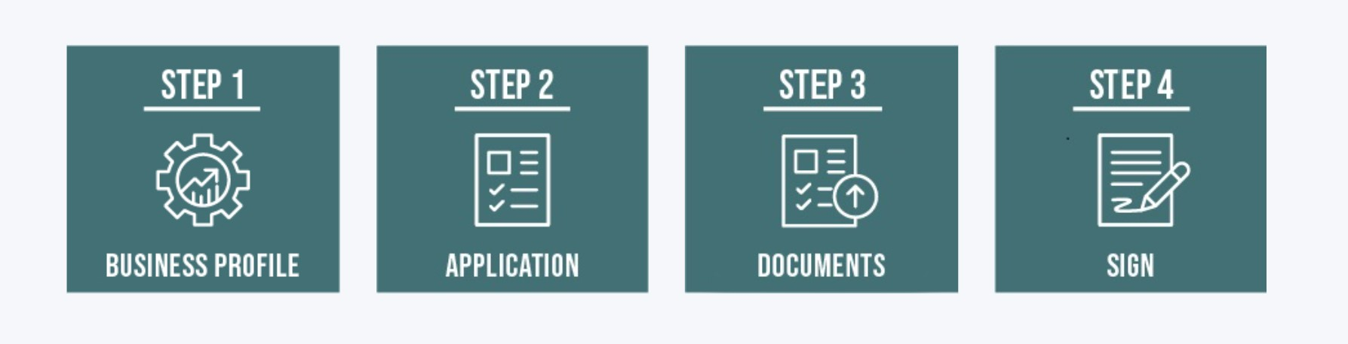
Steps: General overview
Step 1: Confirming business and contact information
Step 2: Application questions
Step 3: Document management
Step 4: Signature and submission of the application

Slide 25
Step 1: business profile
Review the business contact information
Subgrantee applicants will be able to update primary contact information
Subgrantee applicants may add an Authorized Certifying Official (if different from primary contact)
Subgrantee applicants may add an alternative contact
Subgrantee applicants will upload SAM.gov registration
Subgrantee applicants will upload state business registration documentation

Slide 26
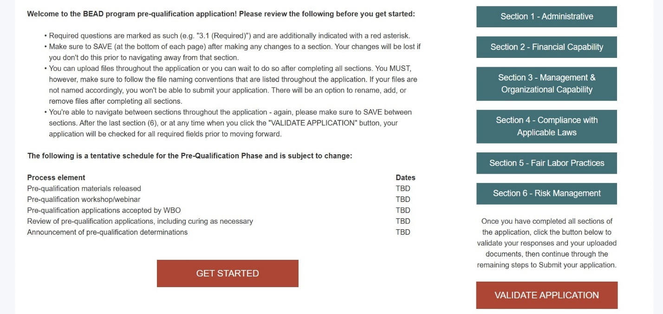
Step 2: application
Provide narrative responses, upload documents, and certify statements as required by the Initial Proposal Volume II

Slide 27
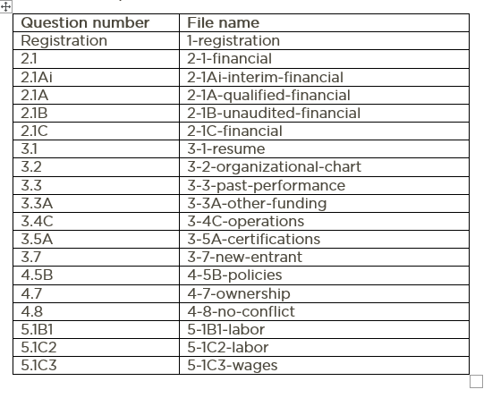
Step 2: application - documents
Uploaded documents must be named according to the file naming guidelines to be validated by the portal
Subgrantee applicants should reference the Application Guide for file name requirements
File name guidelines are written out in every question’s instruction section and aggregated in Appendix A
Ex: the file for 3.1 should be named “3-1-resume.pdf”

Slide 28
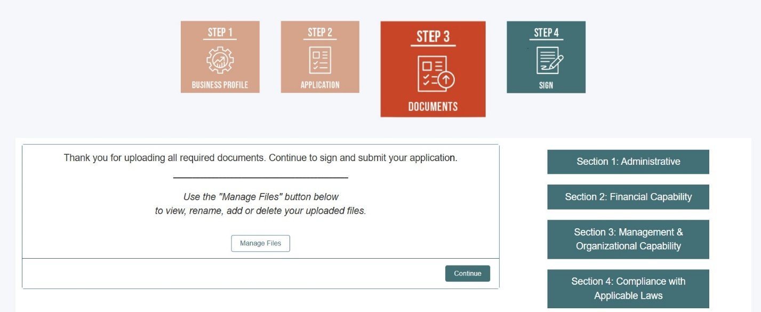
Step 3: documents
Subgrantee applicants can manage documents in Step 3

Slide 29
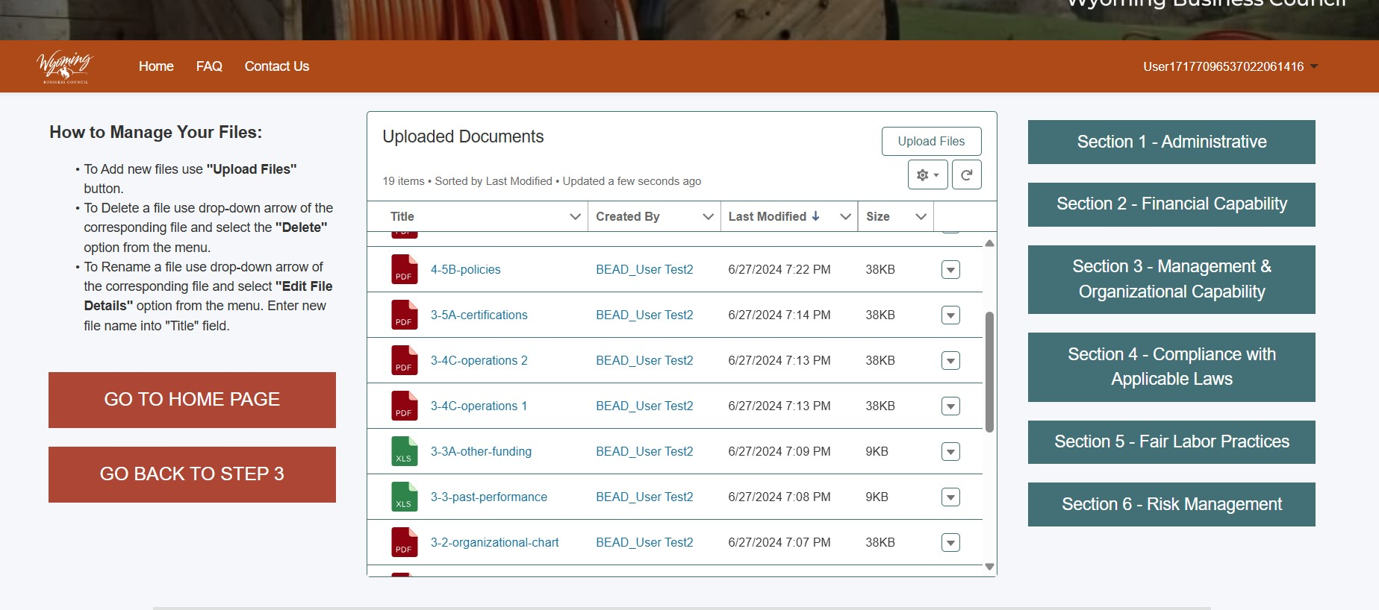
Step 3: documents
Editing or deleting files

Slide 30
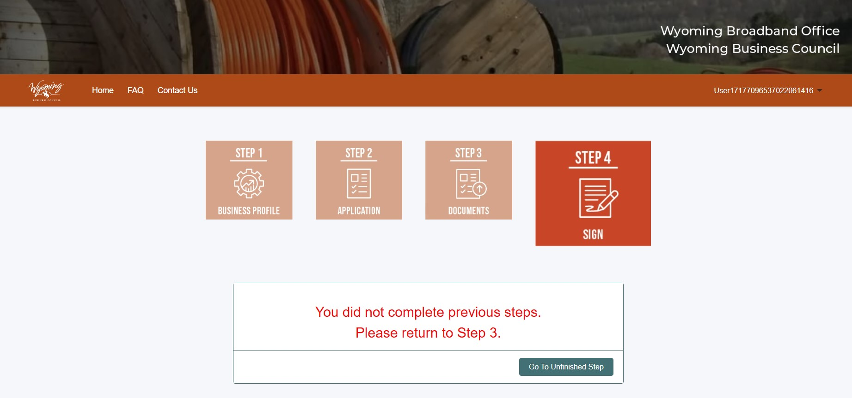
Step 4: sign
Subgrantee applicants will not be able to proceed unless they have completed all previous steps of the application

Slide 31
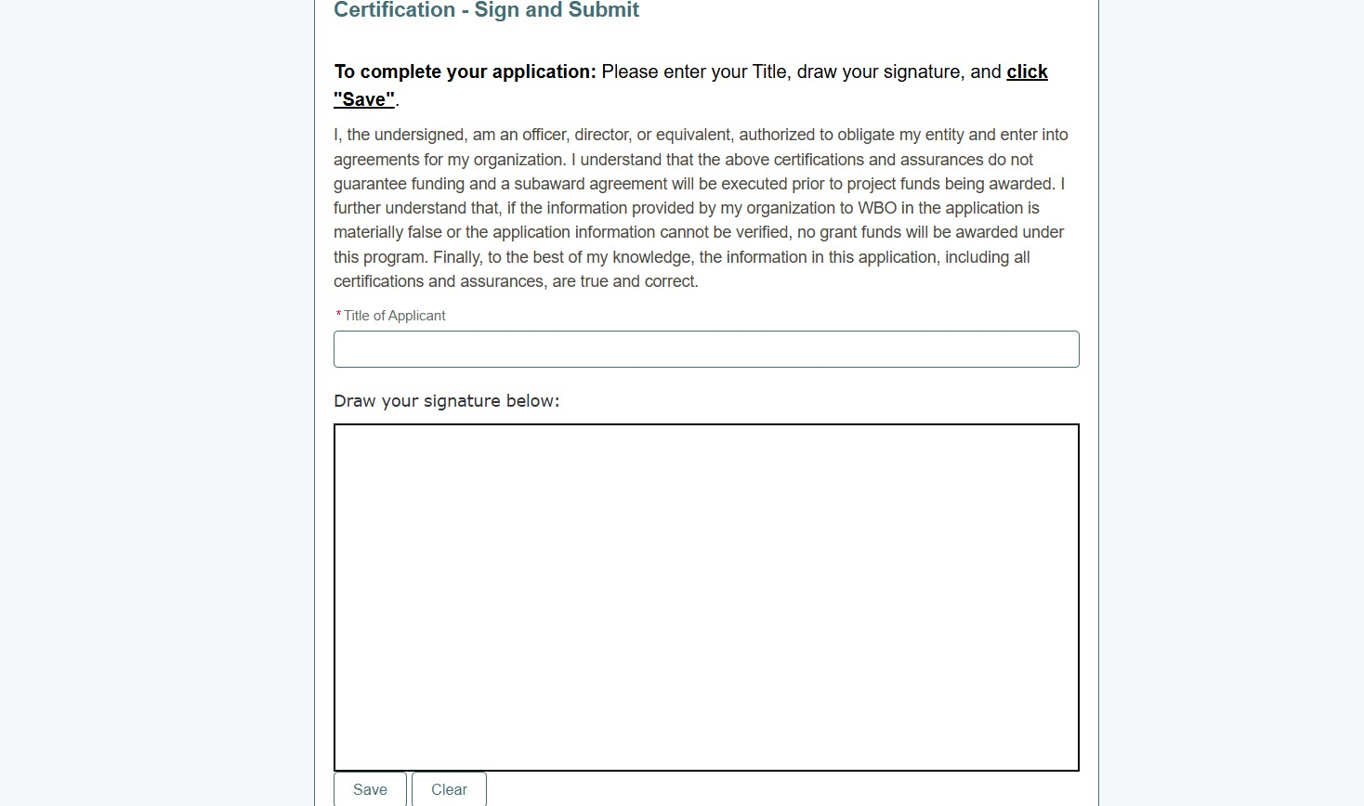
Step 4: sign
The Authorized Certifying Official must provide an electronic signature to complete the application

Slide 32
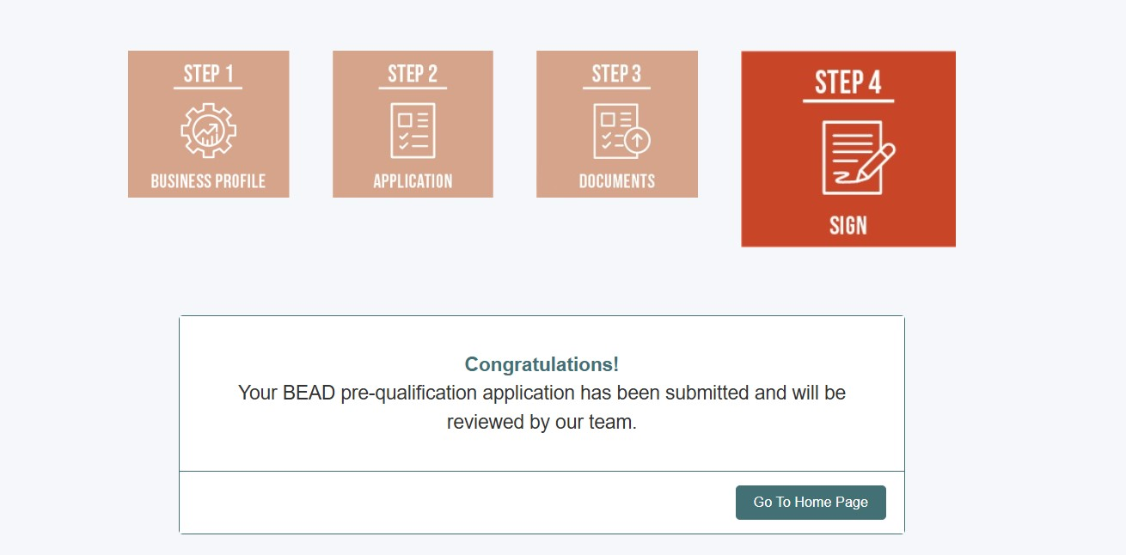
Step 4: sign
Subgrantee applicants should see a confirmation of submission

Slide 33
Revising the application
Subgrantee applicants will be given the opportunity to revise application materials if WBO identifies insufficiencies
Subgrantee applicants will receive notification if any application items need to be addressed
All revised materials must be submitted to the portal
Subgrantee applicants will typically have five (5) business days to provide requested materials

Slide 34
Application window
Important dates for the Prequalification Application:
Event | Date
Application materials released | August 5, 2024
Application opens | August 15, 2024
Technical Assistance webinar | August 26, 2024
Application closes | September 14, 2024
Application revisions | September/October 2024

Slide 35
Final notes

Slide 36

Checklist for submission
Materials to prepare for prequalification application:
Identify authorized certifying official and key application contacts
Compile company name, address, TIN, contact information
Collect financial statements and other documentation
Identify key managerial staff, update resumes and organizational charts
Authenticate active registrations with the state and SAM.gov
Identify projects of similar scope and/or size for past performance
Ensure accurate ownership documentation
Review BEAD NOFO, WBO Initial Proposal Volume II, and other relevant documents

Slide 37


Additional information to keep in mind
WBO will not be scoring subgrantee applicants based on what is submitted in the prequalification application
Some items submitted in the prequalification application may be reviewed during the Scoring Phase with the additional context provided by specific project applications
Prequalification will help save time and resources, especially given the limited 365-day window set by NTIA for submission of the Final Proposal and subgrantee selection process

Slide 38
For more information
https://wyomingbusiness.org/broadband/
broadbandoffice@wyo.gov

